Slide 1


Travel & invest

Slide 2

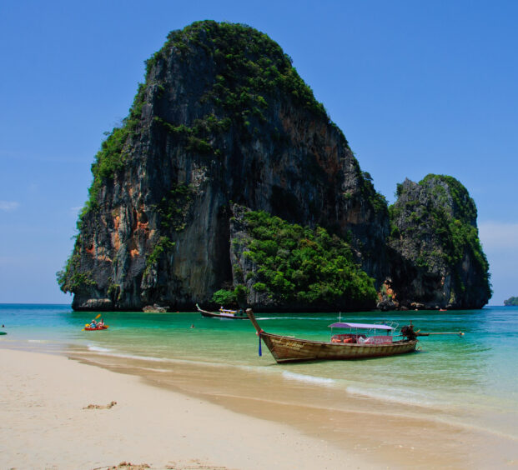
Wouldn´t it be nice to travel safely?

Slide 3
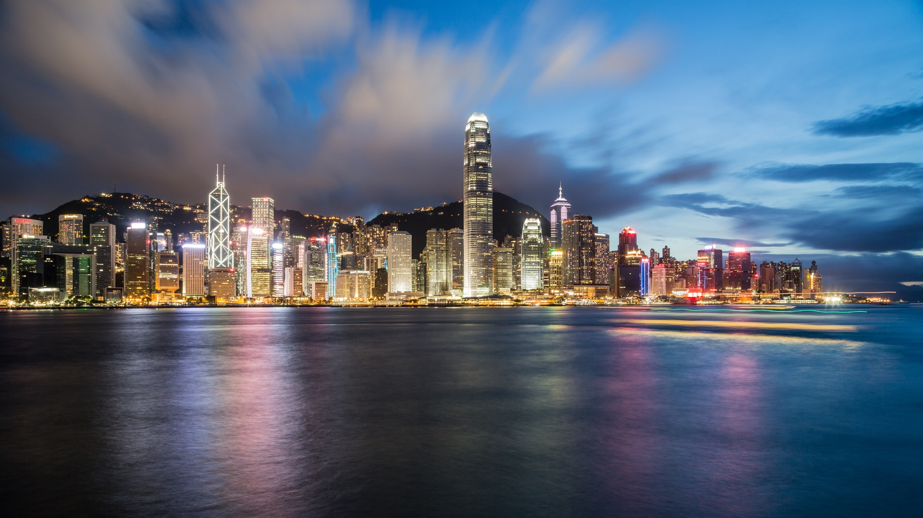

Slide 4
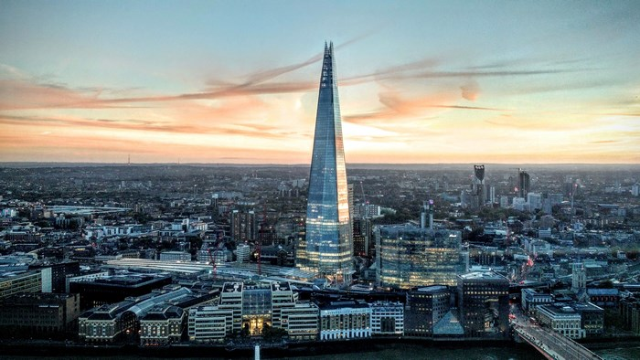

Slide 5
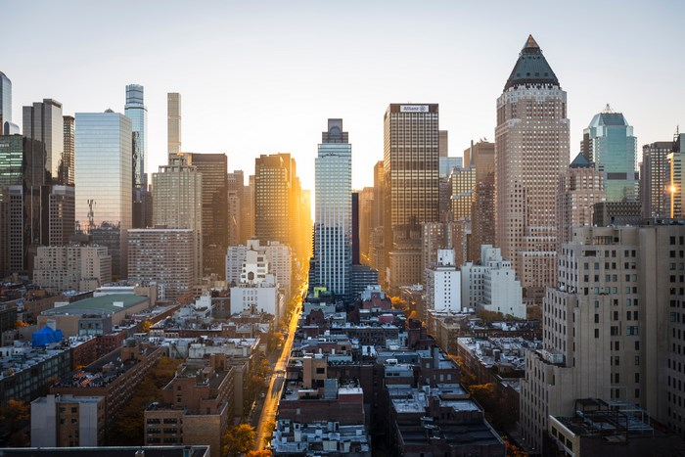

Slide 6
